Slide 1
A quantum leap to data science
by Molu Shi
2016.3.4 at FirstFuel

Slide 2
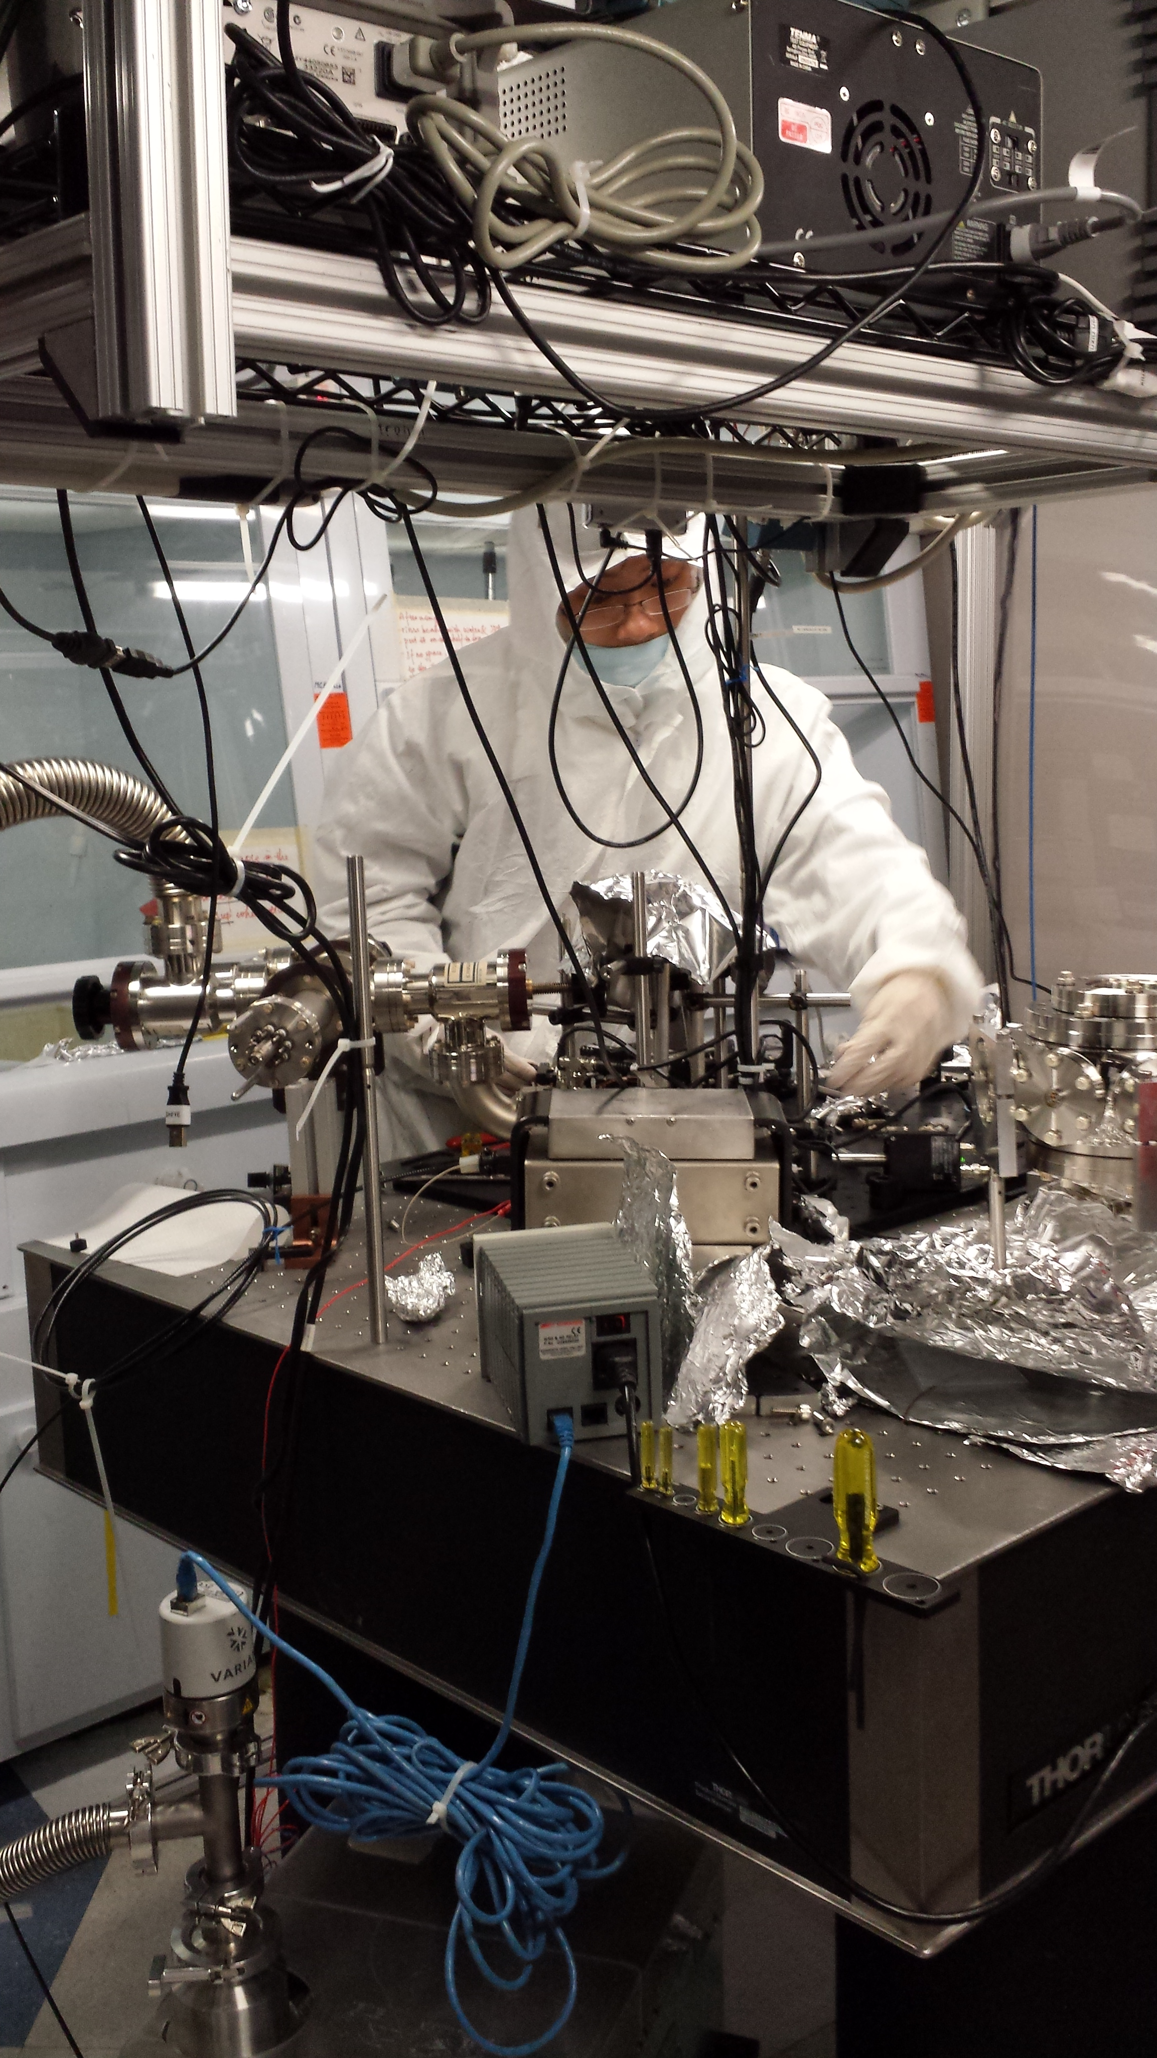

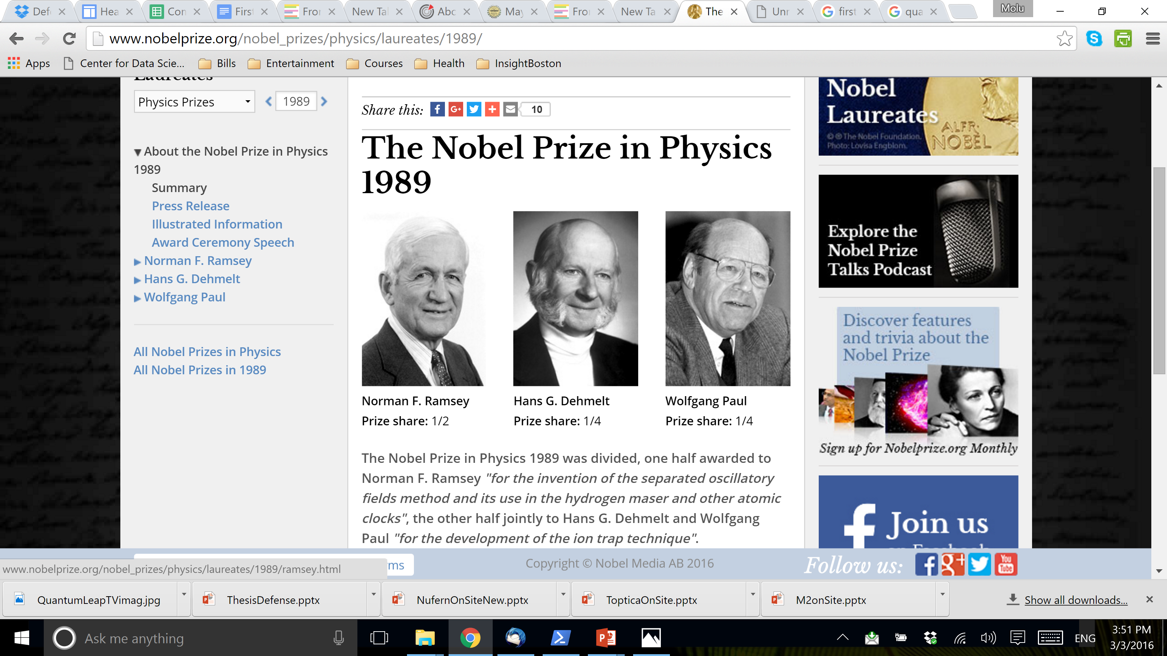


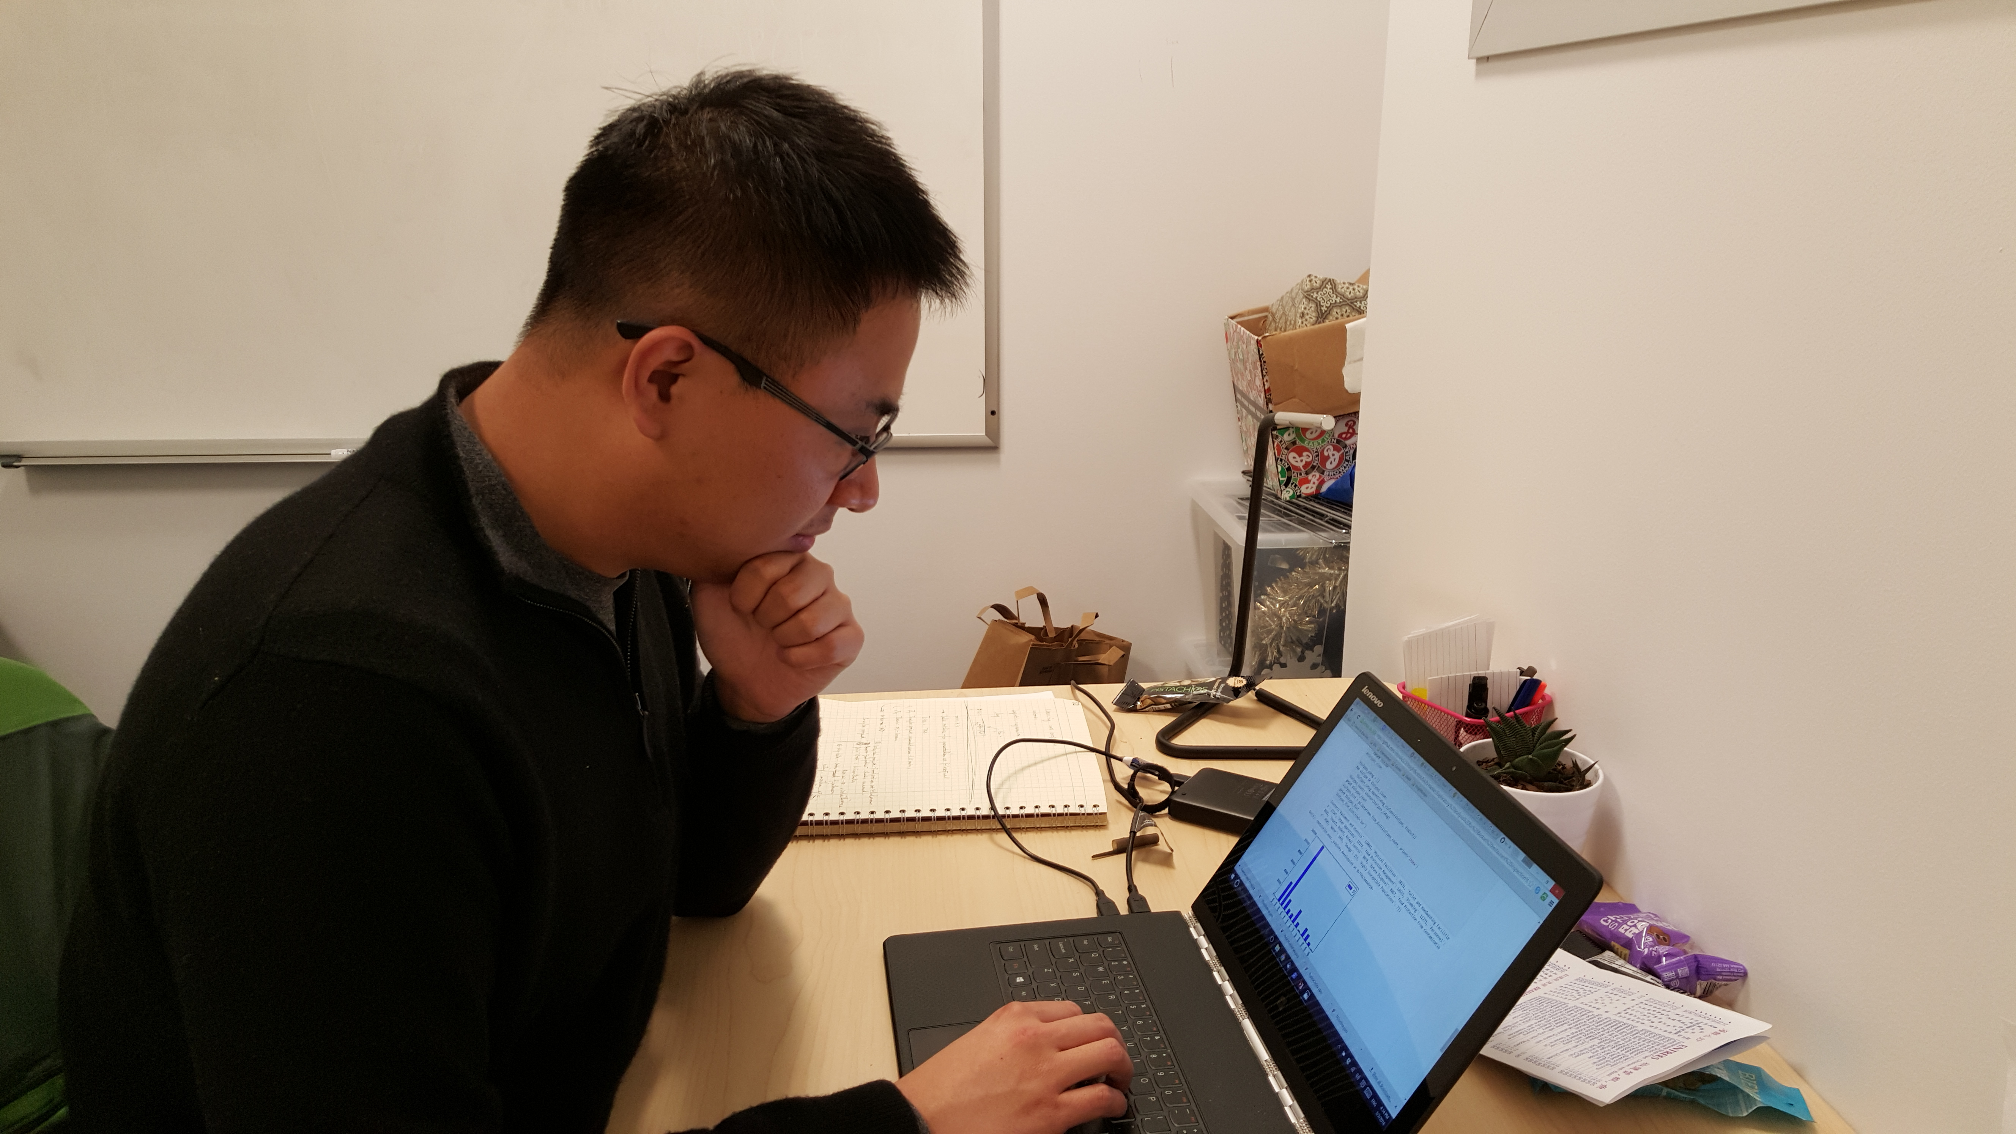
What quantum leap?
Physics: transition between two quantum states
Nobel prize in 1989
Science fiction/TV show in 1989
Me: my transition from a quantum physicist to a data scientist

Slide 3
Outline
3 weeks at Insight:
Challenges behind smartinspector.me
6 years in quantum computing:
From theory to hardware, and data

Slide 4

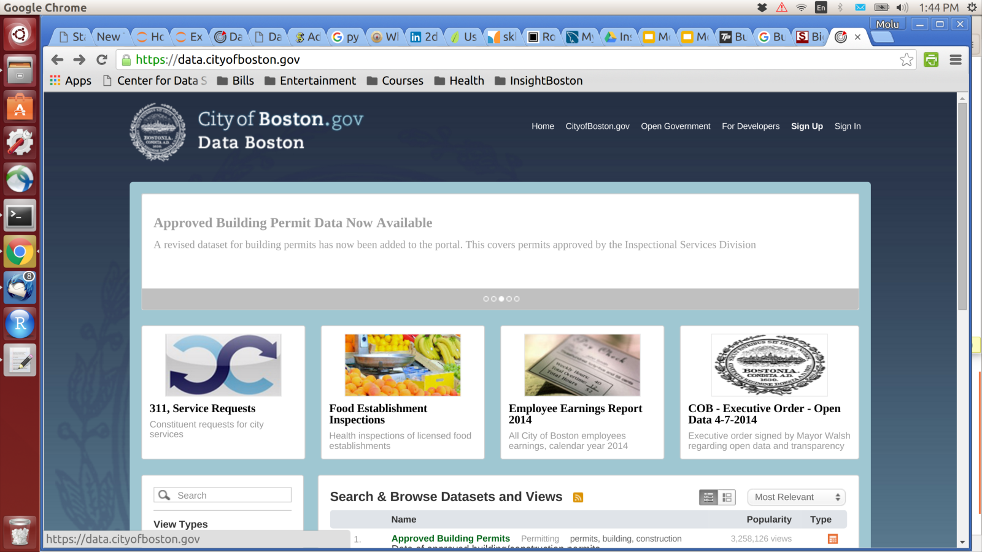
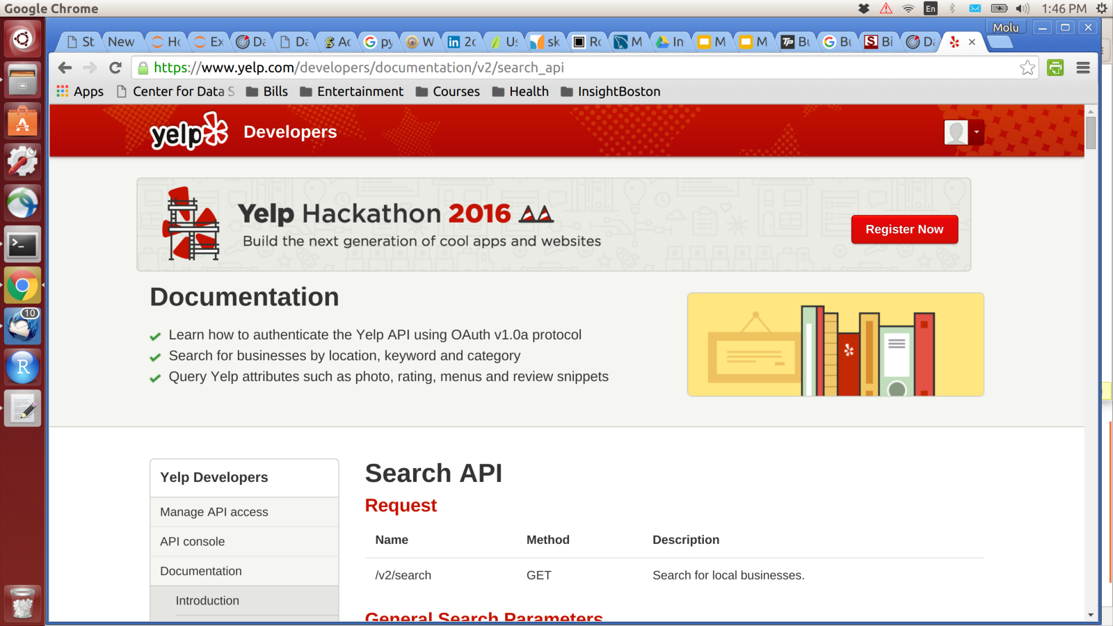
Smartinspector.me
Predict restaurant inspection:
health violation type: e.g. water quality, animal control
violation level: scale between 1 to 4
1
1
Food protection
Plumbing
Insect/Animal control
Personnel health
...
...
Water
4
4
Property value
Customer rating
Location
Business type
3
2
1

Slide 5
Path to product
Week 1
Decision on project
Week 2
Exploratory analysis
Model construction
Week 3
Visualization
Data warehouse construction
Cleaning
Validation
Scikit-learn
Website
Pandas + SQL
JavaScript + SQL
Flask +
Week 1
Week 2
Frustrated
Week 3
Finish product
Focused on plan
Simplify to-do list
Lots on to-do list
Ambitious
Solutions
Challenges

Slide 6
Challenge I: matching data
No key available
Inspection data entered by staff by hand -> errors
E.g. Macdonald vs McDonald's, Tohia vs Tokia
Solution: fuzzy matching with FuzzyWuzzy, levenshtein distance

Slide 7
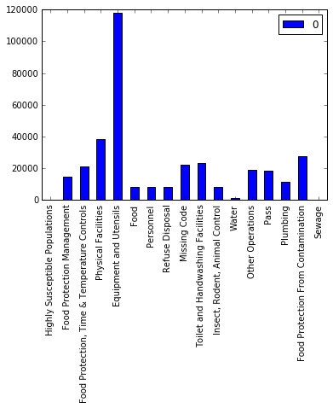
Challenge II: unbalanced data
Multiclass classification
Fair metric such as F1 or AUC doesn’t apply
Solution: SMOTE resampling
Idea:
Over sample minority data within the existing minority data boundary

Slide 8
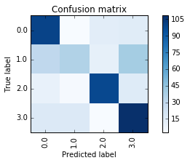
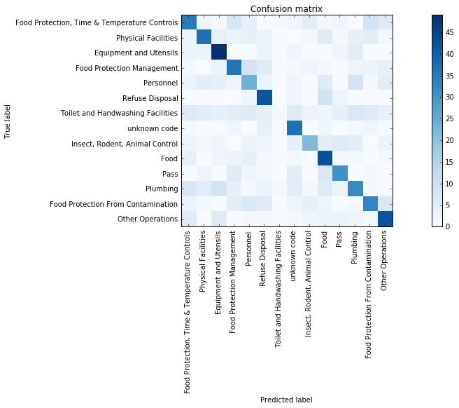
Result:

Slide 9
Insights from Insight experience
Self-motivated
Fast learner
Open to challenges

Slide 10
Quantum computing
Overview of the field
Why
What
How
My experience and accomplishments

Slide 11
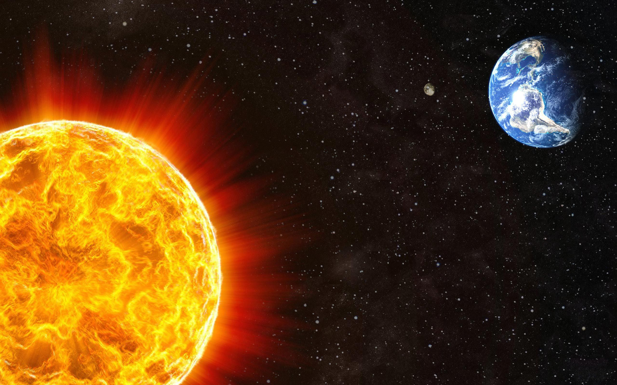
Quantum computing - motivation
Physics: describe and predict interaction using math models
E.g. Orbital motion of earth
Application: satellite launch

Slide 12
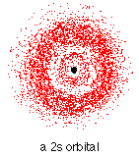


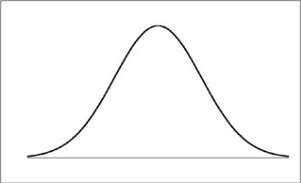
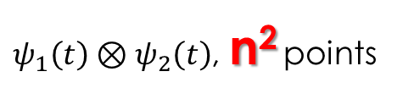
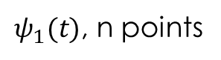
Motivation
Simulation at small scale: exponentially more complicated
NP problem!
Application: precisely simulate chemical reaction, protein folding, etc.
Classical
(x,p)
(x₁,p₁,x₂,p₂)
Quantum
$ψ_{1}\left(t\right)⊗ψ_{2}\left(t\right)$, n² points
$ψ_{1}(t)$, n points

Slide 13
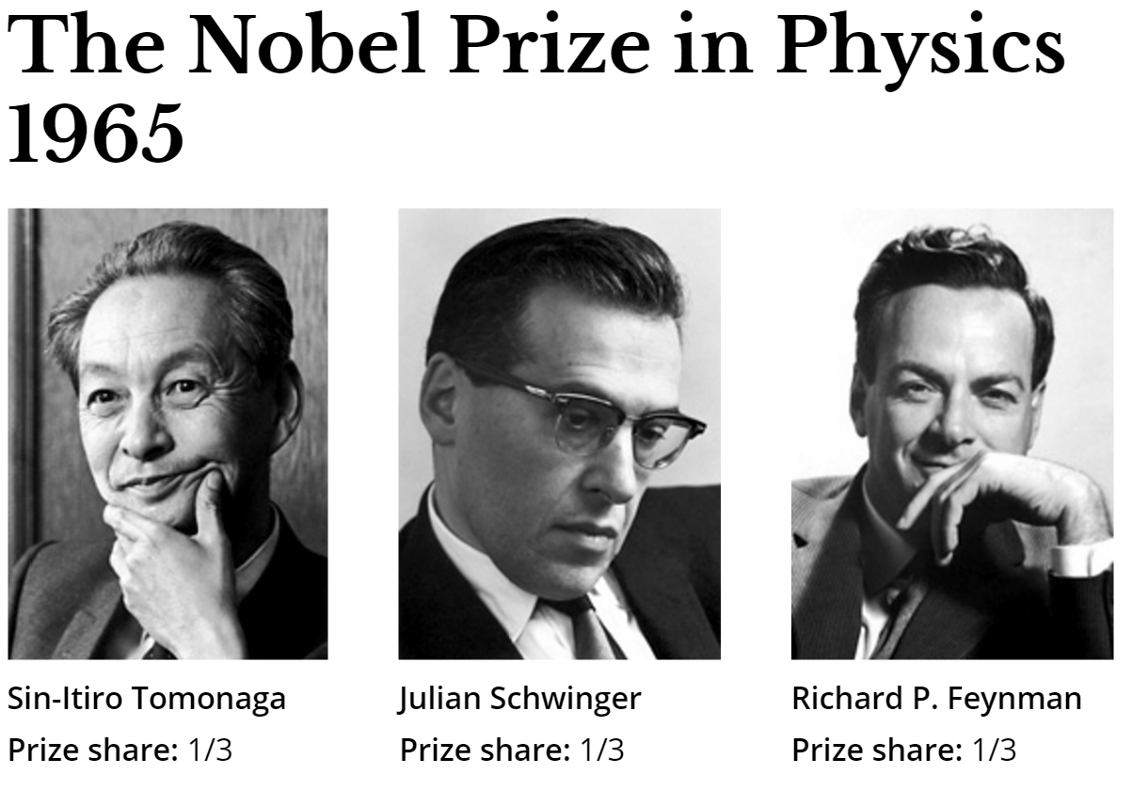
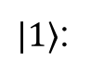
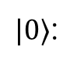
Quantum computing - Use a quantum system to simulate quantum systems
Computer: a device that computes - binary operations
Classical computer
Quantum computer
1: digital high
1: excited state
$|1〉$:
5V
Quantum operation
0V
0: gnd
0: gnd state
$|0〉$:
Bit
Quantum bit (qubit)

Slide 14

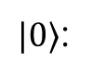
Quantum algorithm gold rush
New data representation – new algorithms
NP problems in classical computing might have polynomial solution!
E.g. integer factorization
Application: cryptography = NSA’s interest = $ Funding!!!
1: excited state
$|1〉$:
Quantum operation
0: gnd state
$|0〉$:
Quantum bit (qubit)

Slide 15
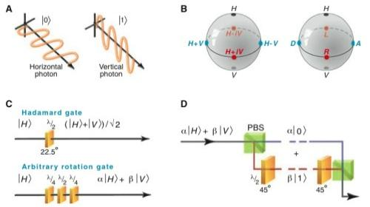
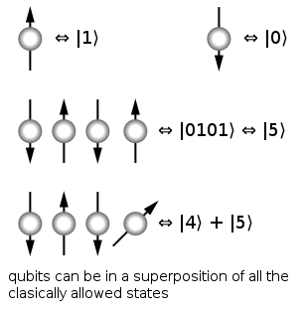
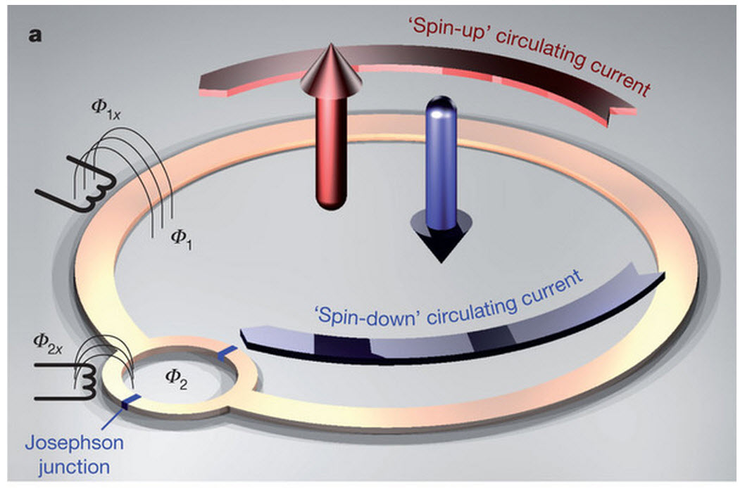
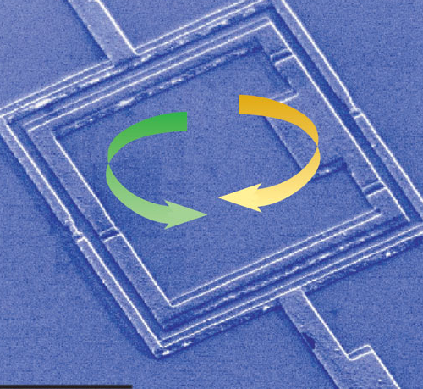
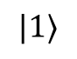

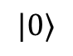

Quantum computer – how to build
1: excited state
$|1〉$:
Quantum operation
0: gnd state
$|0〉$:
Spin + NMR
Photon + wave plate
Josephson Junction
+ microwave
Atom + laser
$$|1〉$$
$$|0〉$$

Slide 16


Challenges
Fault tolerance – hardware accuracy vs. error correction:
Electronic computer: majority voting, no hardware limit
Message: 1
Repeat message:
1 -> 1111
Error:
1111 -> 1011
Correction:
1011 -> 1111
Received:
1111 -> 1

Slide 17
Challenges
Fault tolerance – hardware accuracy vs. error correction:
Electronic computer: majority voting, no hardware limit
Quantum computer: cannot clone quantum state
Gap between theory and experiment:
State-of-art error correction algorithm: 0.01% error threshold tolerance
State-of-art CNOT gate error: 1%

Slide 18
Model implementation
1: excited state
$|1〉$:
Quantum operation
0: gnd state
$|0〉$:
Spin + NMR
Photon + wave plate
Josephson Junction
+ microwave
Atom + laser
$$|1〉$$
$$|0〉$$

Slide 19
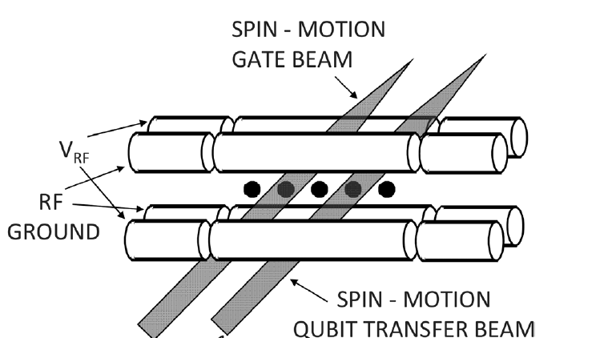
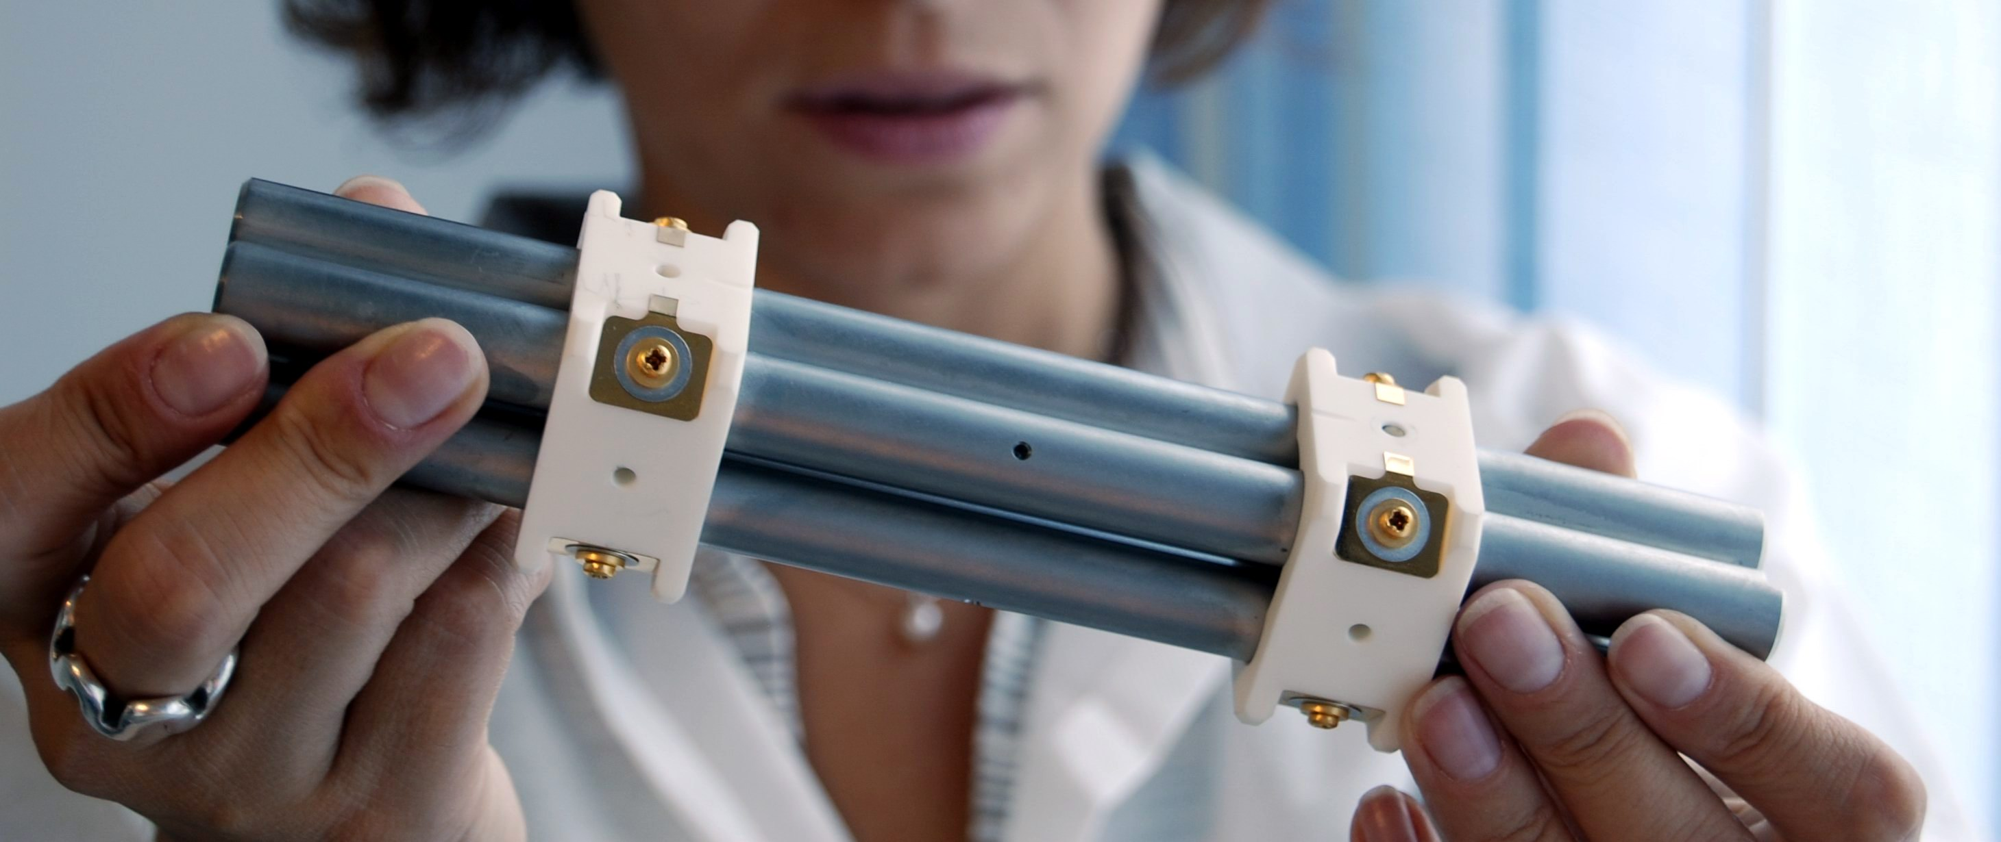
Model implementation
Atom + laser
Best fidelity: atomic clock, with best accuracy
Best defined qubit: atoms all same
Challenge: Hard to scale, manually assembled trap, mass-production difficult
$$|1〉$$
$$|0〉$$
Josephson Junction
+ microwave

Slide 20
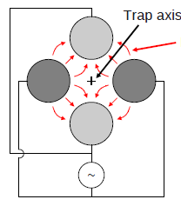
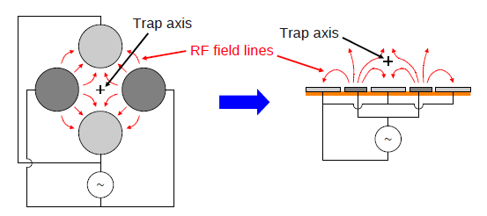
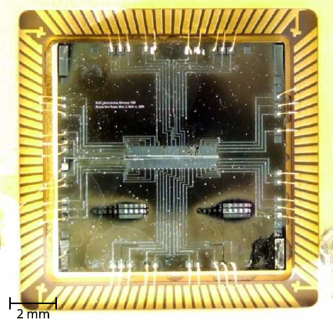
Planar ion traps – a scalable method
Laser beam for cooling, gate operation and spectroscopy
Trap axis
Trap axis

Slide 21
My 6 years in quantum computing
Year 1
Decision on project
Year 2-4
Build experiment
Python
Theory
Mechanical
Run experiment
Experiment design
Optics
Year 5-6
Vacuum
Nanofabrication
Python
Year 1
Year 2-4
Frustrated
Year 5-6
Finish product
Focused on plan
Simplify to-do list
Lots on to-do list
Ambitious
Solutions
Challenges

Slide 22
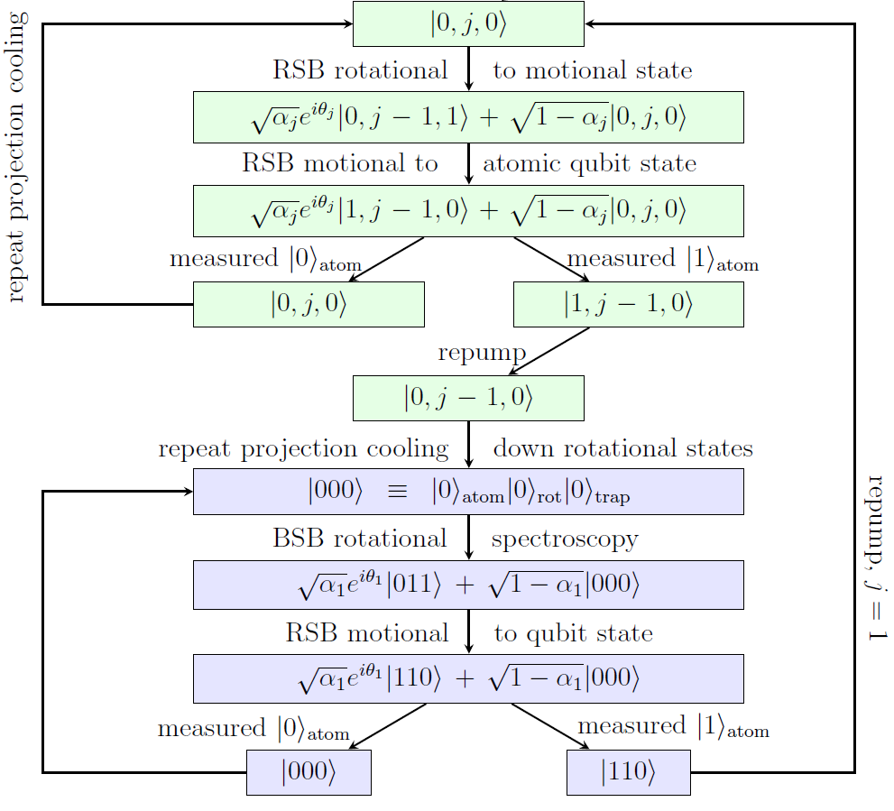
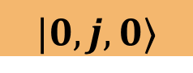

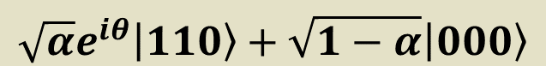
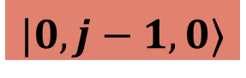
My 6 years in quantum computing
Theory: quantum algorithm with trapped molecules:
$$|0,j,0〉$$
Re-Initialization
Cooling
Re-Initialization
$$|0,j−1,0〉$$
$${|0〉}_{atom}{|0〉}_{rot}{|0〉}_{trap}$$
Spectroscopy
Re-Initialization
$$\sqrt{α}e^{iθ}|110〉+\sqrt{1−α}|000〉$$

Slide 23
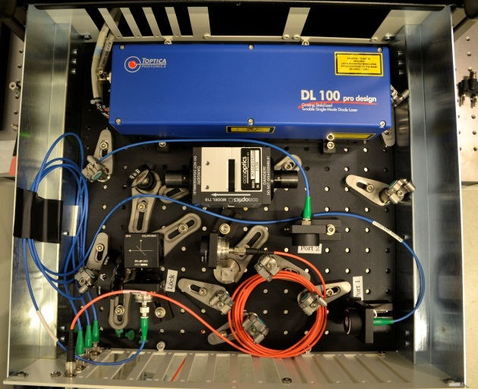
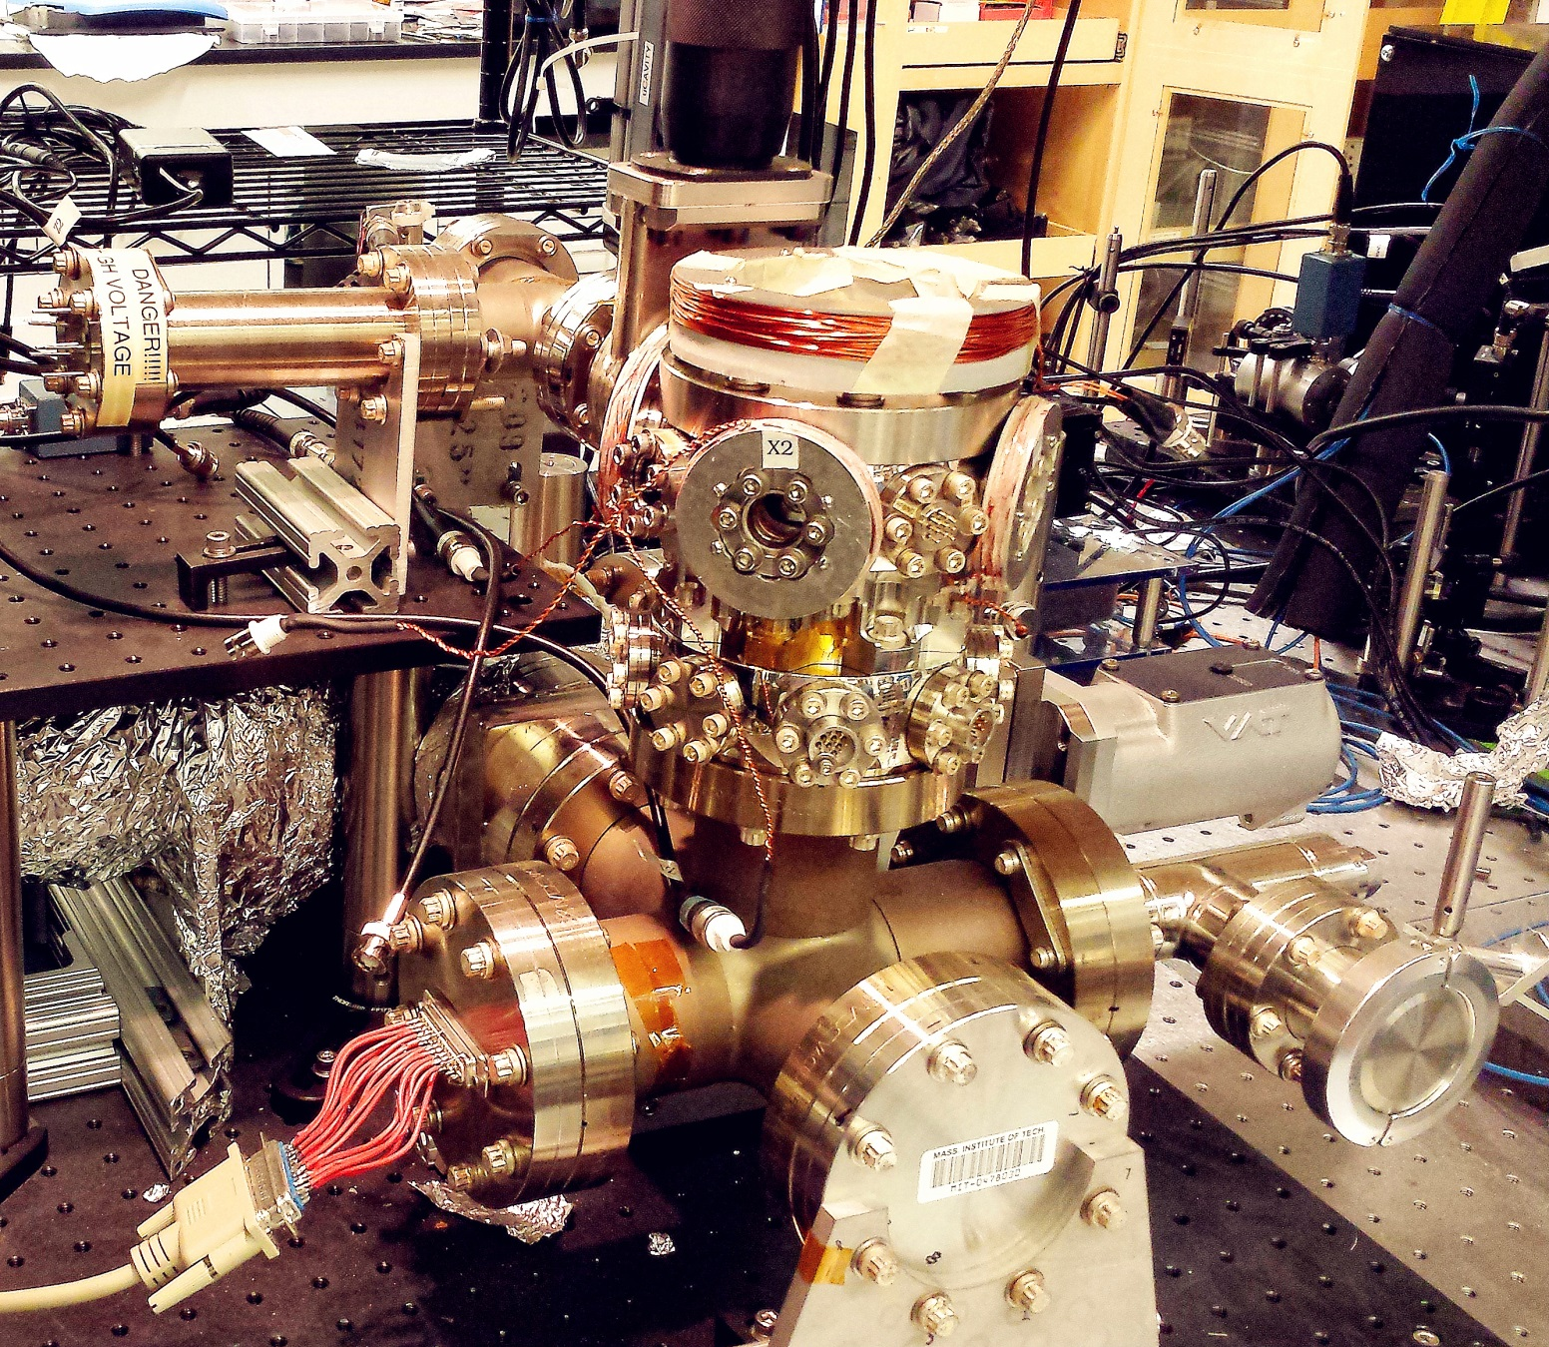
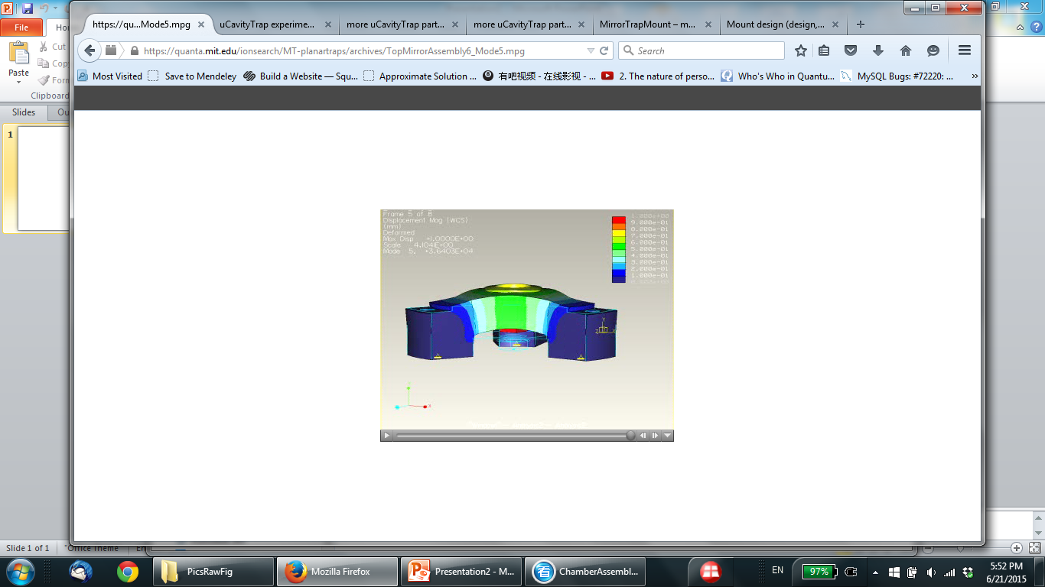
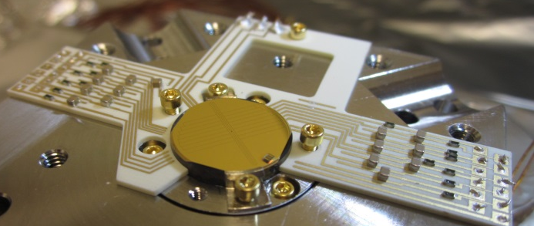
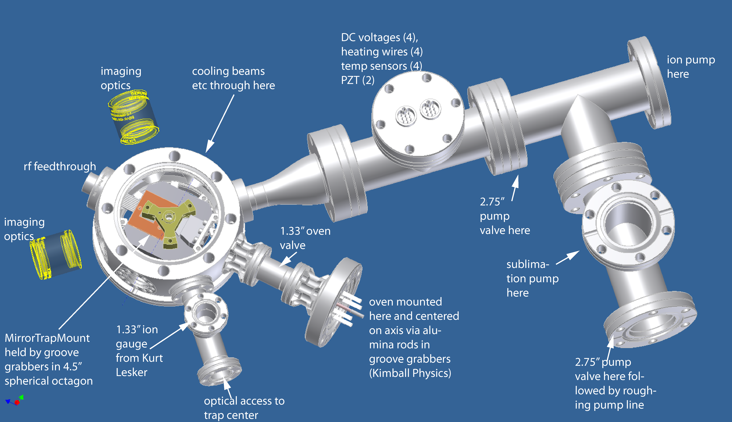
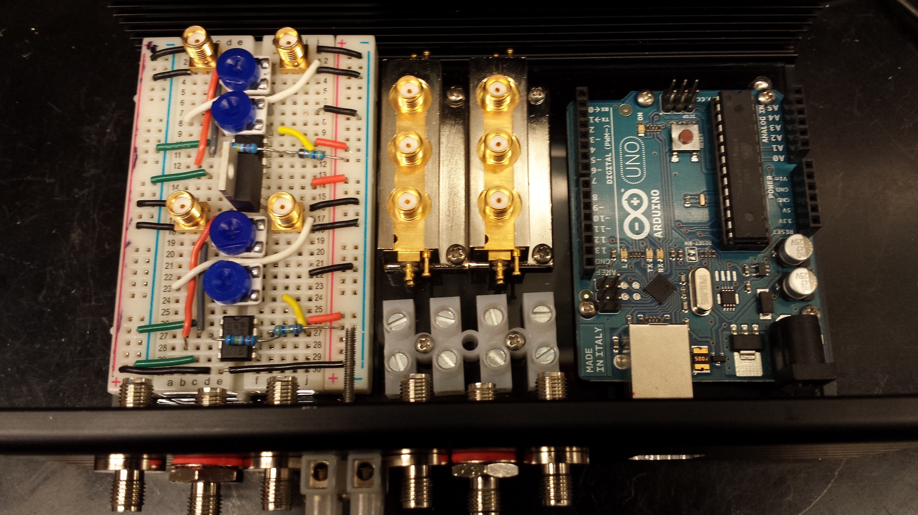
Laser and optics
Built the experiment
vacuum, mechanical design
Trap, nanofabrication
Electronics, control

Slide 24
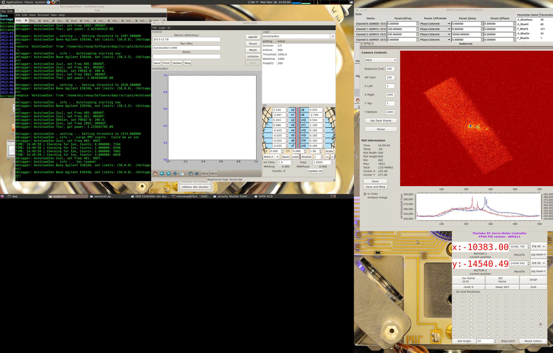
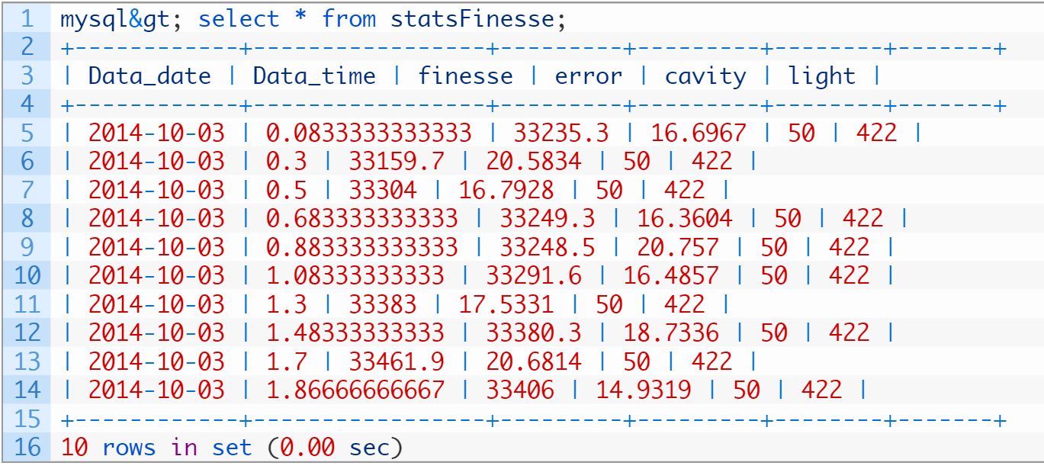
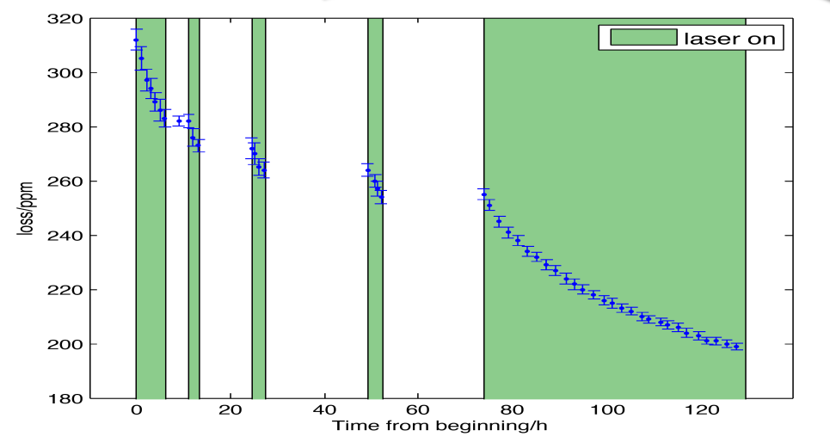
Ran the experiment
Python scripting for experiment control
Data warehousing
Analysis

Slide 25
Insights
Self-motivated
Fast learner
Open to challenges

Slide 26
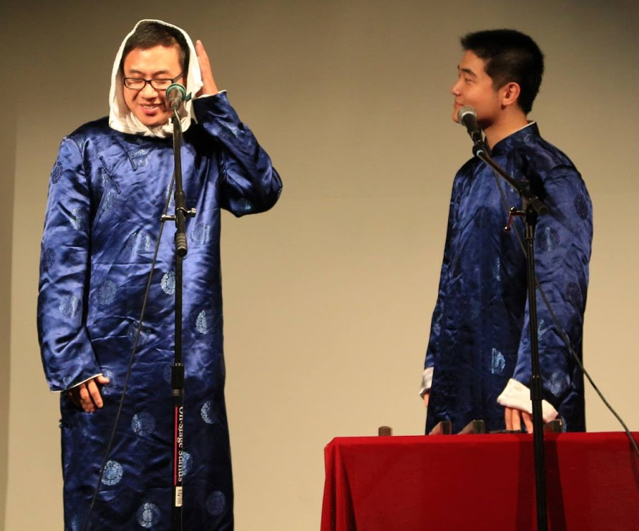
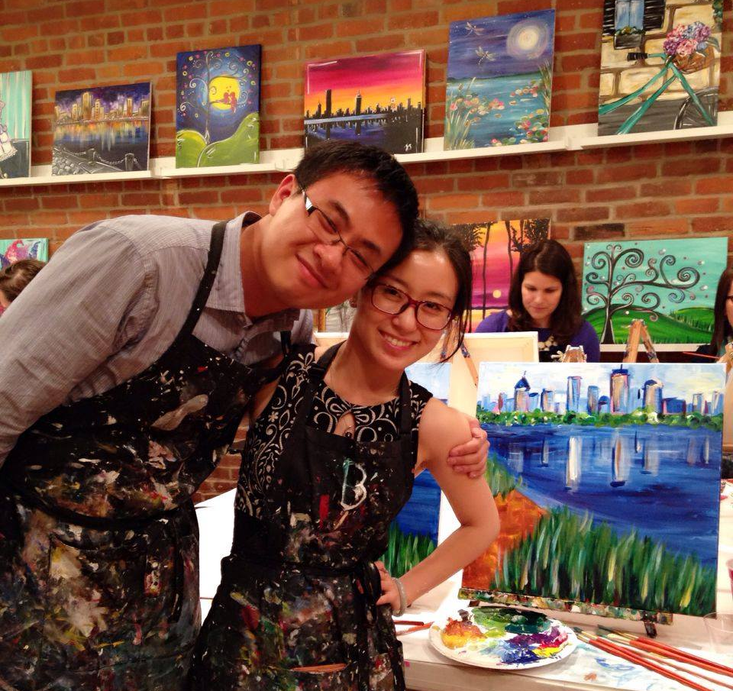
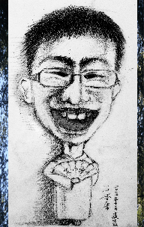
About me
Like comedy and painting

